Slide 1
Homepage
This section details what the homepage should look like. On slide 2, you will see 3 clear things on the hompage wireframe
A welcome message
Ability to start a new trip
Ability to see previous trips
The home page is CRITICAL as it is the first thing users will view

Slide 2
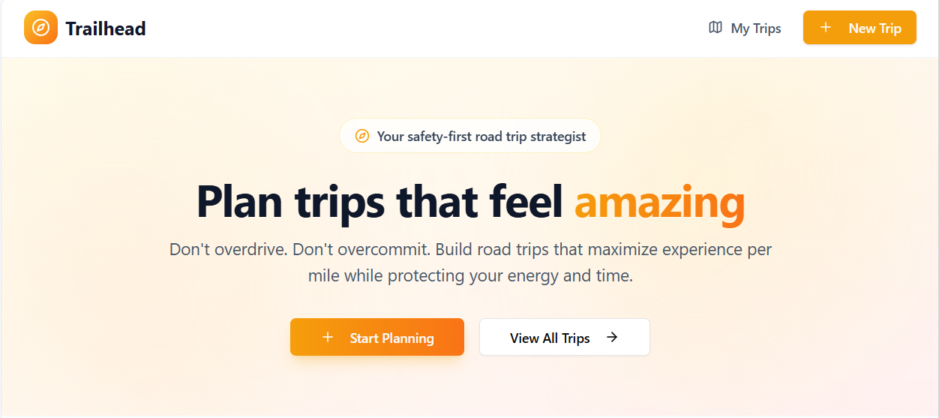
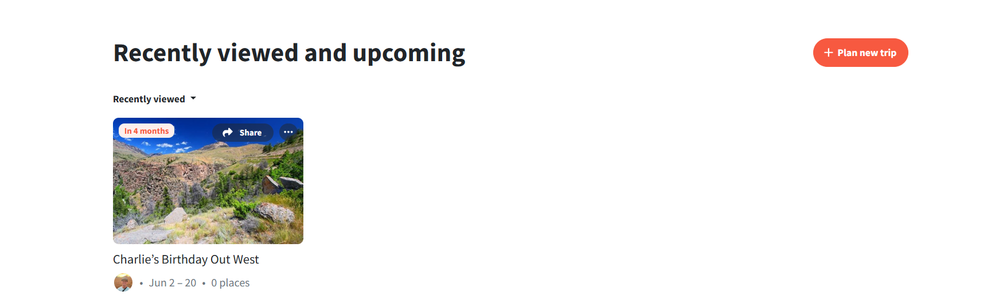
Your Trips

Slide 3
Start a new trip
If the user selects start new trip on the homepage, a modal should pop up. The modal will have 6 sections for the user to click through to detail the trip. This information should be stored with the trip so that the AI assistant can help plan appropriately.
Notice:
The banner on the top of each section on the modal letting the user know where they are in the process.
The six steps are: trip basics, who’s going, travel style, lodging, budget, trip must haves
The wireframes for this modal are slides 4-9

Slide 4
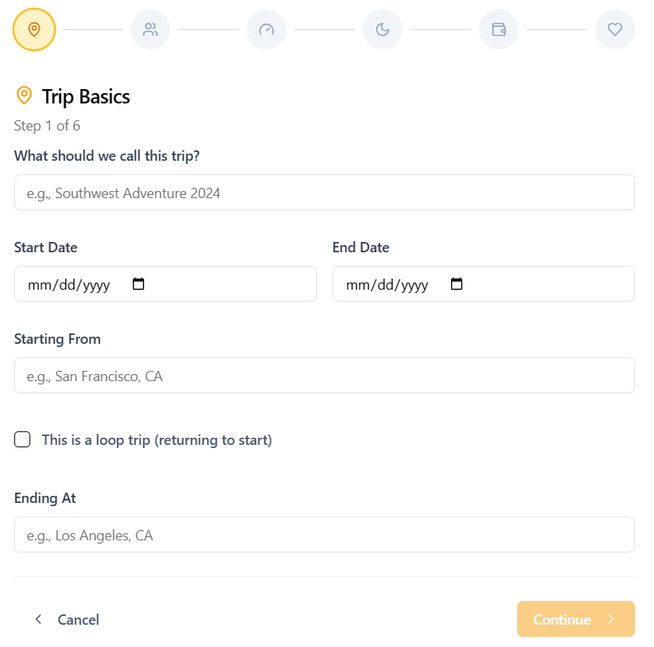

Slide 5
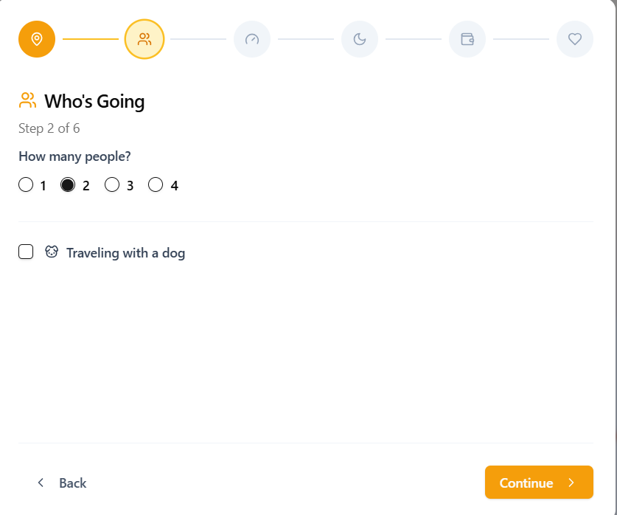

Slide 6
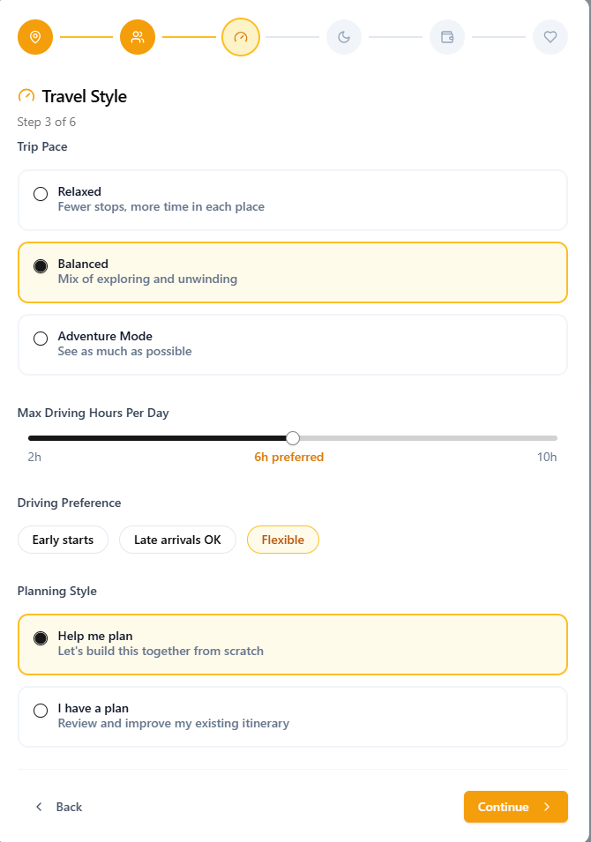

Slide 7
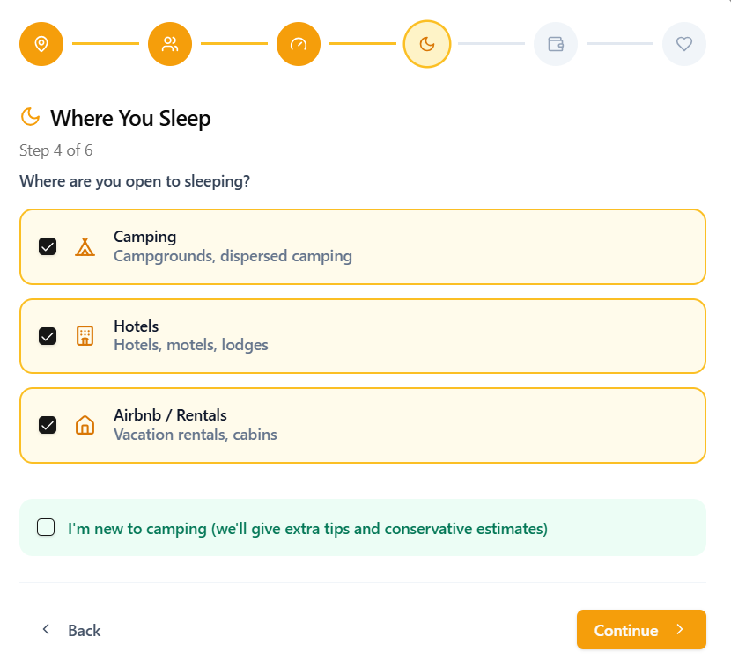

Slide 8
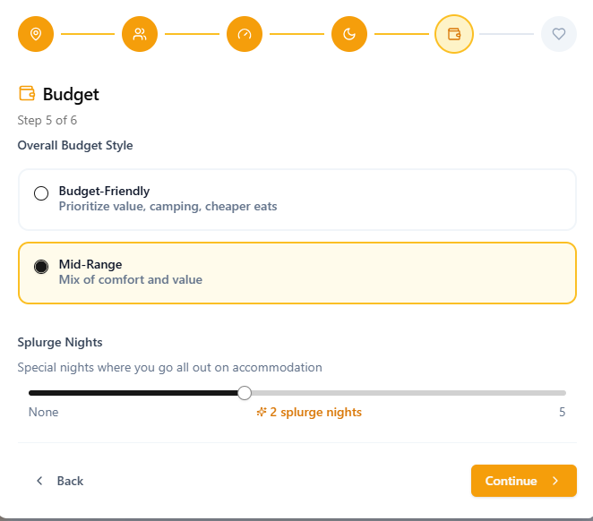

Slide 9
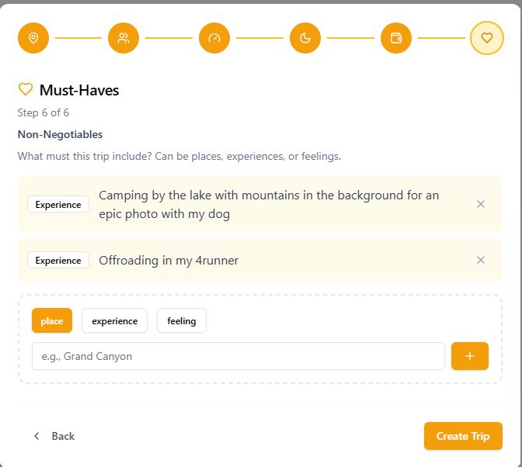

Slide 10
Trip Overview
Once the trip has been started, the user can start building the itinerary & trip activities. There are multiple views on this screen in which the user can toggle
Notice:
The map view – this is to view the route, the stops & activities on the map. This view can be toggled on or off.
The itinerary view: a view to see each days activities. Can be accessed on the side bar
Dashboard view: This gives the overview of key items needed such as reservations, budgeting, passes, etc. It will also have a marker for days yet to plan & any “red flags” or action items to fix

Slide 11
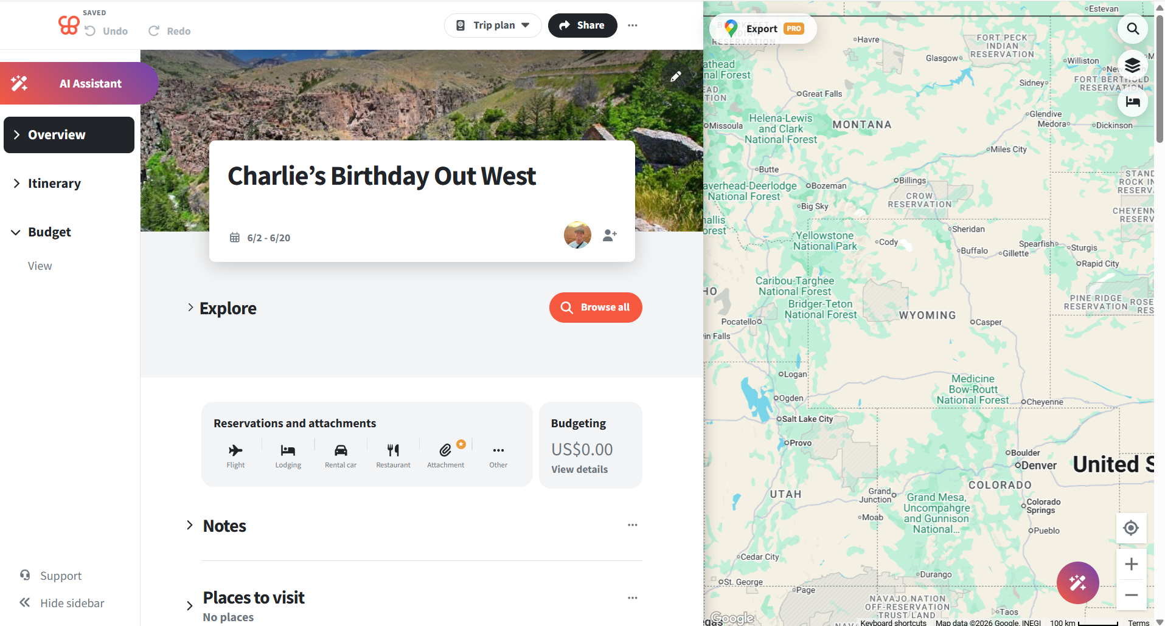

Slide 12
Trip Itinerary
The itinerary breaks down day by day. It can be viewed at a high level or clicked into.
Notice:
Slide 13: The full view of day by day
Note: There should be a validation that multiple days can’t be entered
Slide 14: Able to view the days details
Note: You’re able to see the type of day it is with a visual. In this example, it is a driving day and should have a car icon. It tells where driving to and from, hours of drive & any stops or activities. It also shows where we plan to stay the night
Note: Can add activities to a certain day
Slie 15: Based on the trip details given on slides 4-9, the AI assistant helps call out areas of concern. You can see that it notes the drive time as longer than the user said they wanted. Another example could be choosing to camp but the next morning they plan to do an activity that a dog cannot join on – the AI assistant should call this out as a concern.

Slide 13
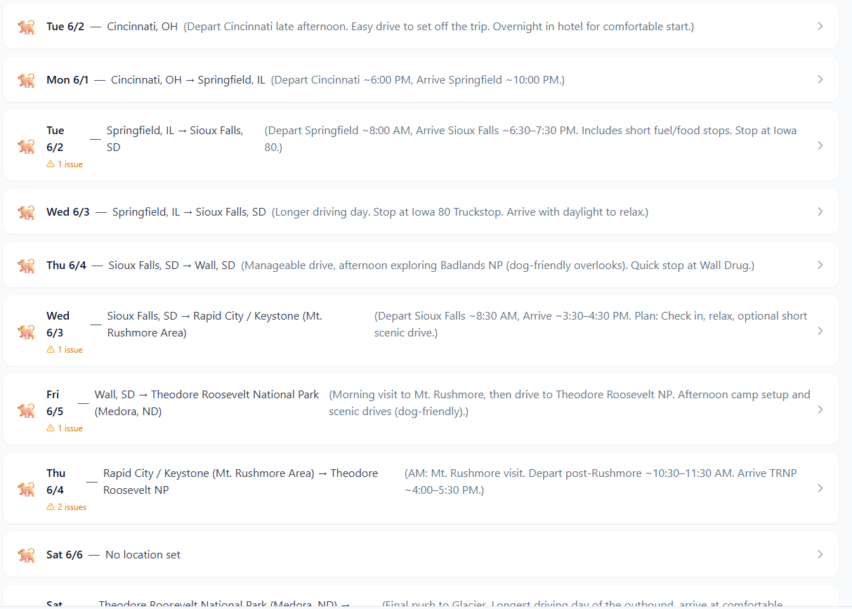
Trip Itinerary

Slide 14
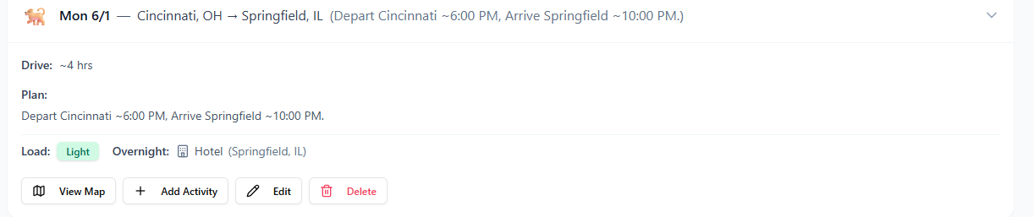
Trip Itinerary

Slide 15
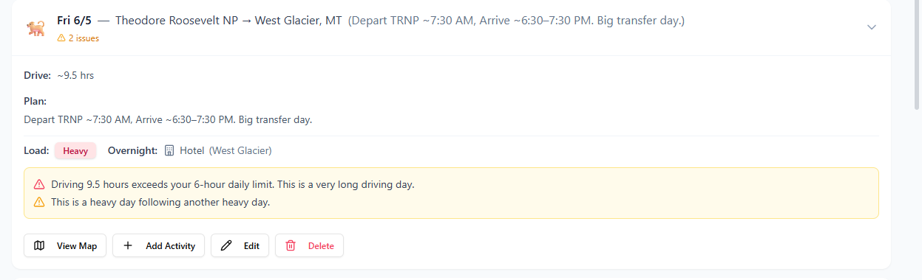
Trip Itinerary

